Slide 1
Hungry Birds Website
BY:
Harris Charalambous - S3742332
Benjamin Kiprotich - S3735277
Ian Romito Descham - S3665571

Slide 2
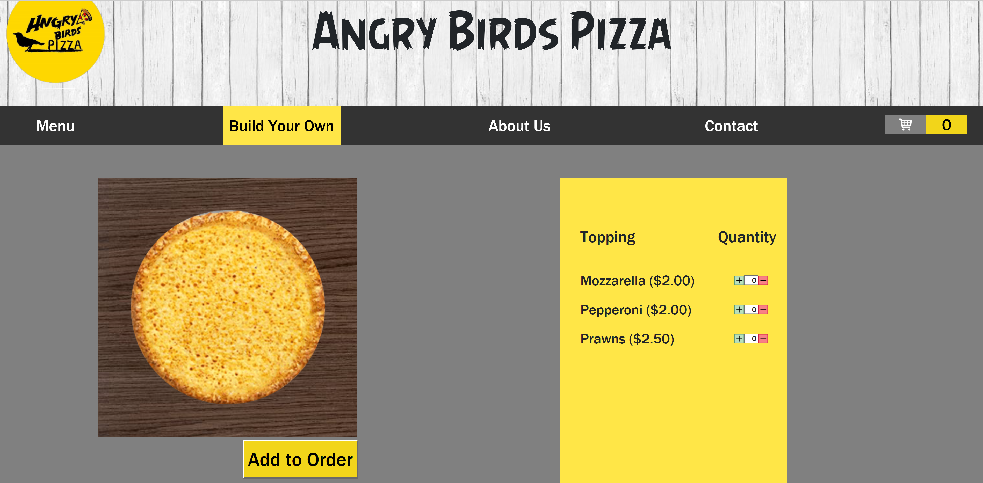

Slide 3
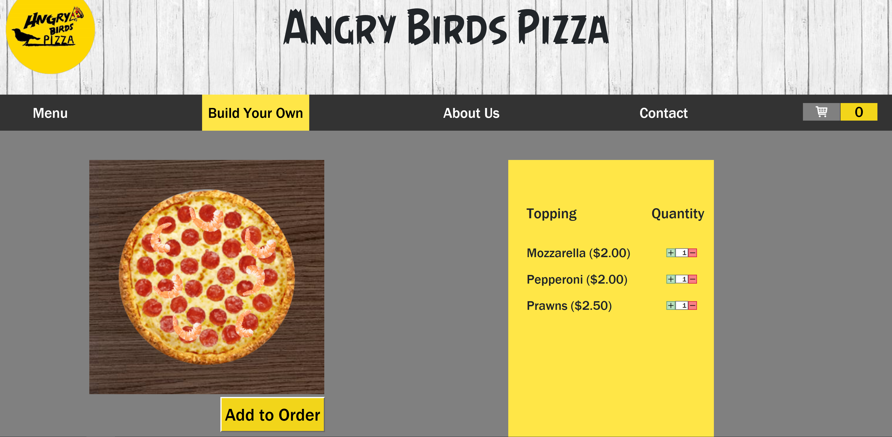

Slide 4
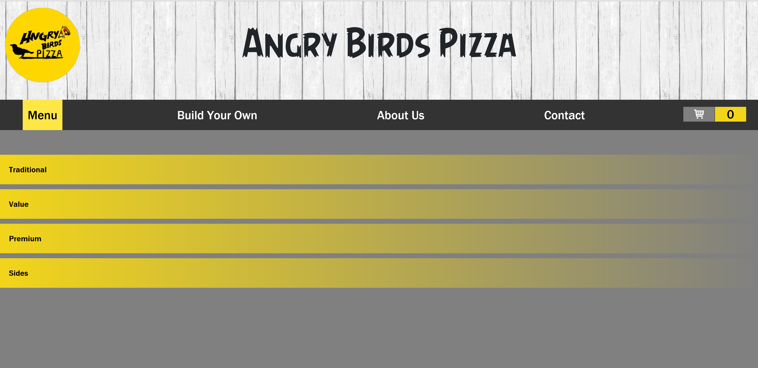

Slide 5
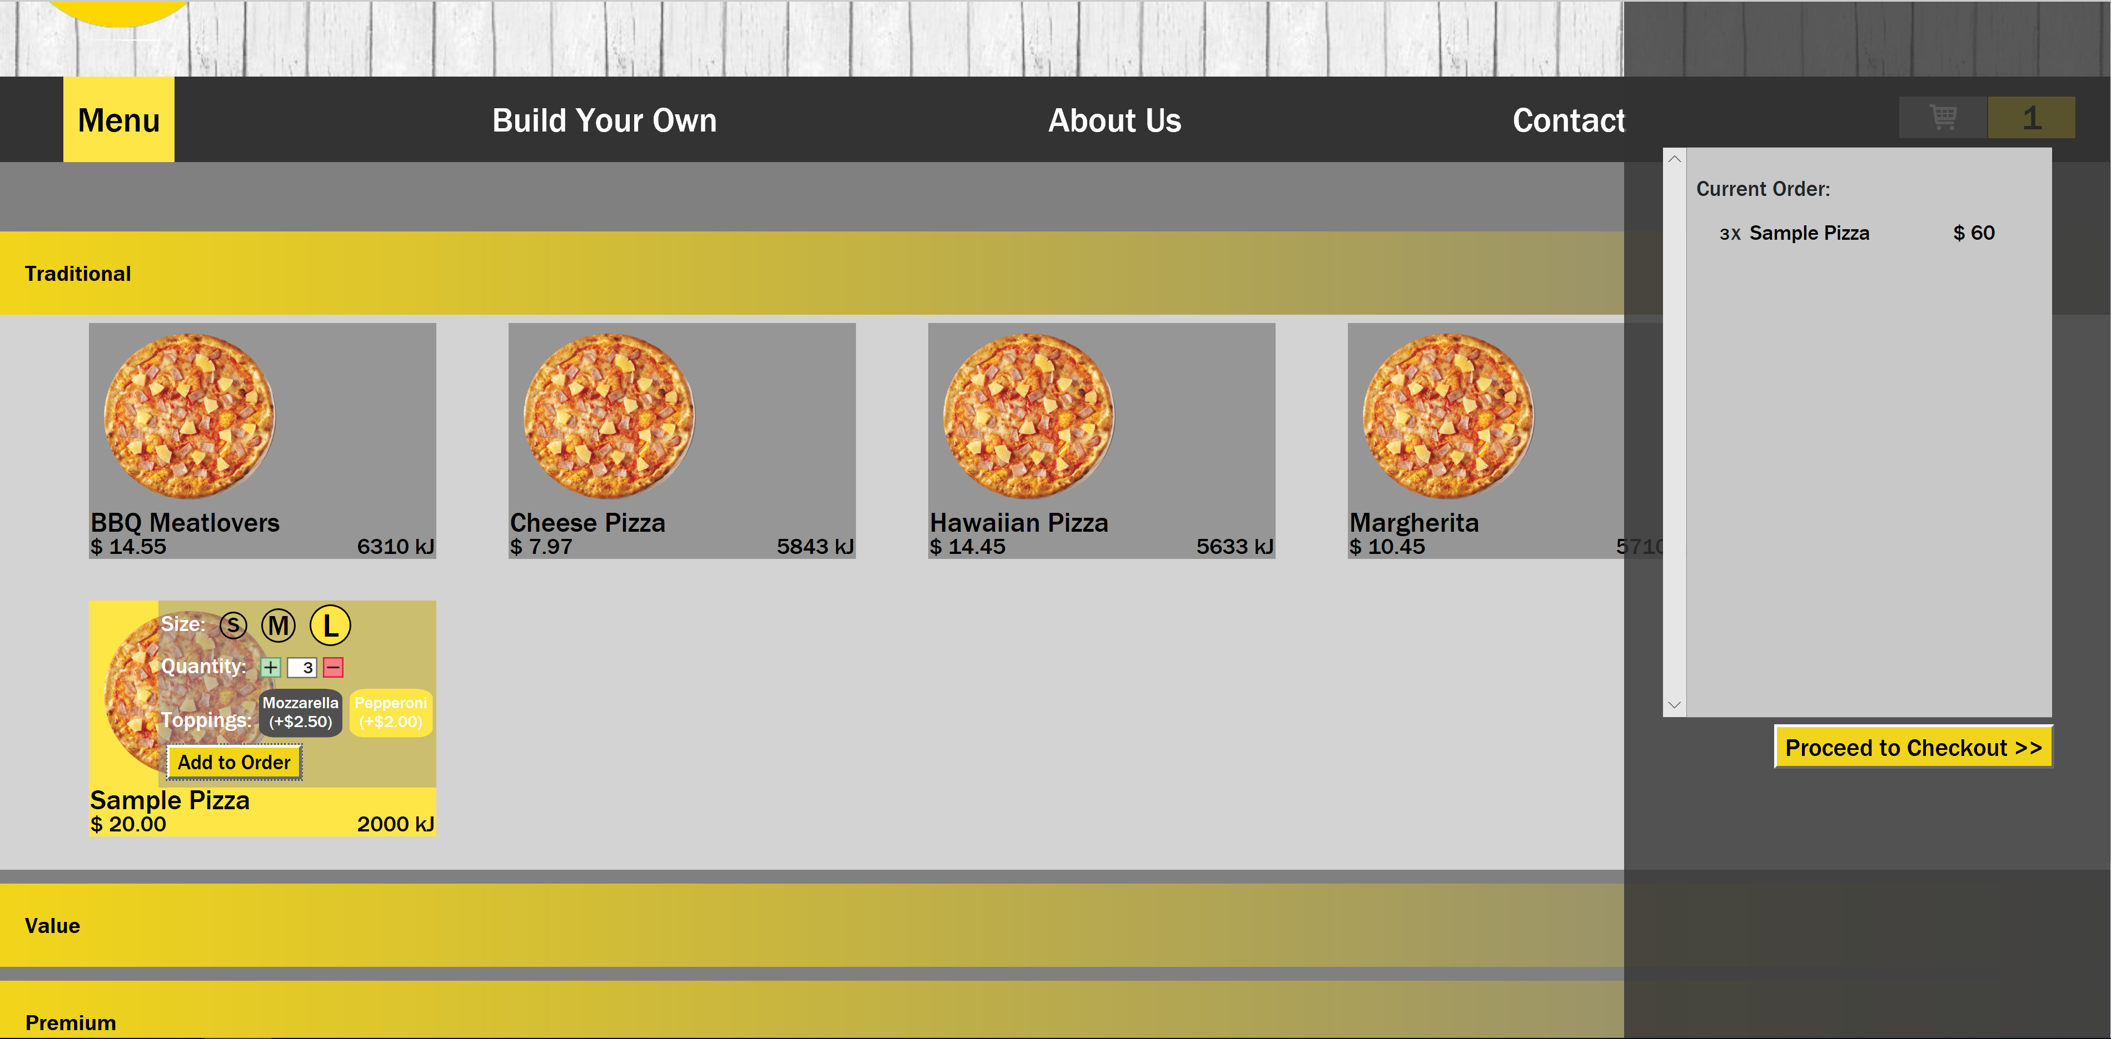

Slide 6



TR-Angry-Birds
Benjamin Kiprotich | Harris Charalambous | Ian Romito Descham
S3735277 | S3742332 | S3665571

